Slide 1


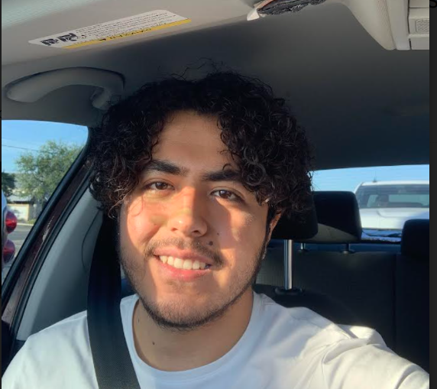
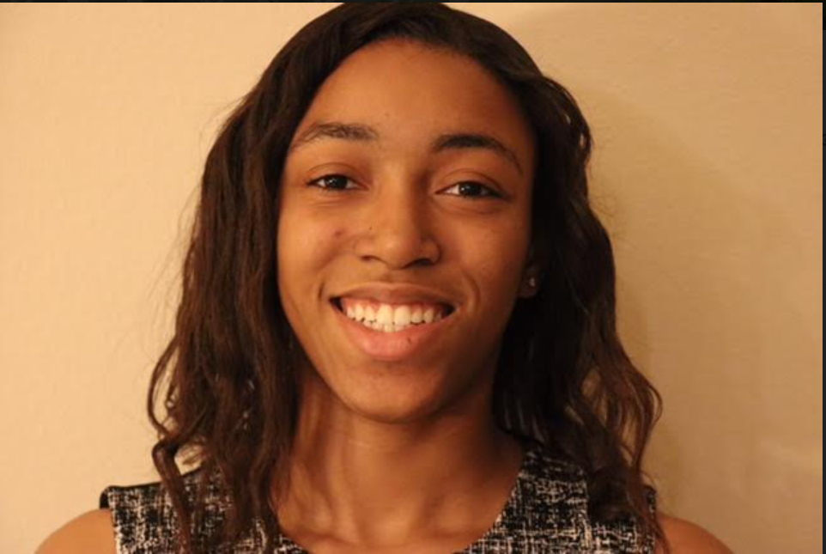
The UTSA Campus
Roadrunners Parking Assistance
UTSA CS 3443 - 001
Spring 2022
Varun Prasad @codekaage
Giovanni Teran
@GioTeran
Shandra Levy
@Shandra-L
Retrouvailles Manishimwe
@retrouvm

Slide 2
The UTSA Campus Roadrunners Parking Assistance
Description
The UTSA campus roadrunners parking assistance app allows commuters to view various different parking prices, and decide which spot is best for them.
Pitch
Our parking assistance app strives to be able to apply an intuitive user interface that depends on human input about parking in real/periods of time and employ an algorithm to display parking options and calculate the most affordable option. Parking can be very rule intensive at our campus and varies significantly, so employing a software to ease that would increase efficiency dramatically.
UTSA CS 3443 - 001
Group 4 - UTSA Campus Parking App

Slide 3
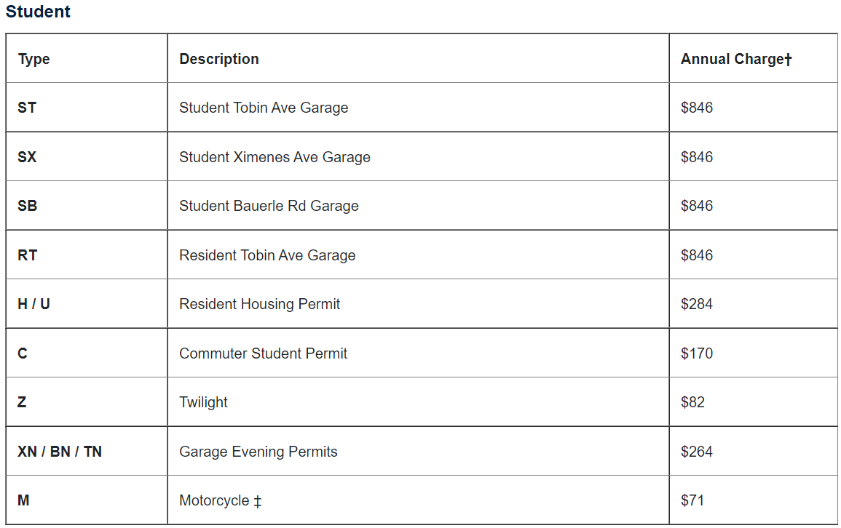
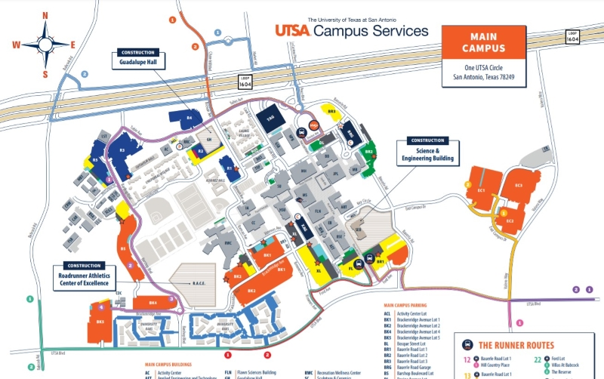
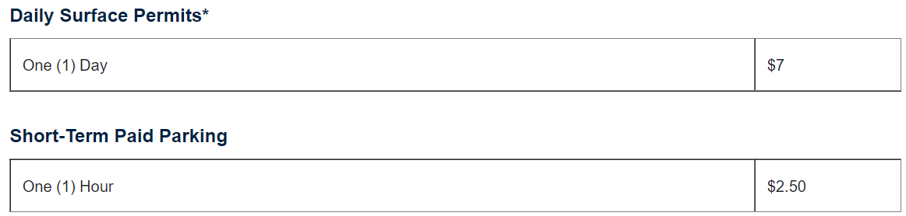
User Interface Design
UTSA CS 3443 - 001
Group 4 - UTSA Campus Parking App

Slide 4
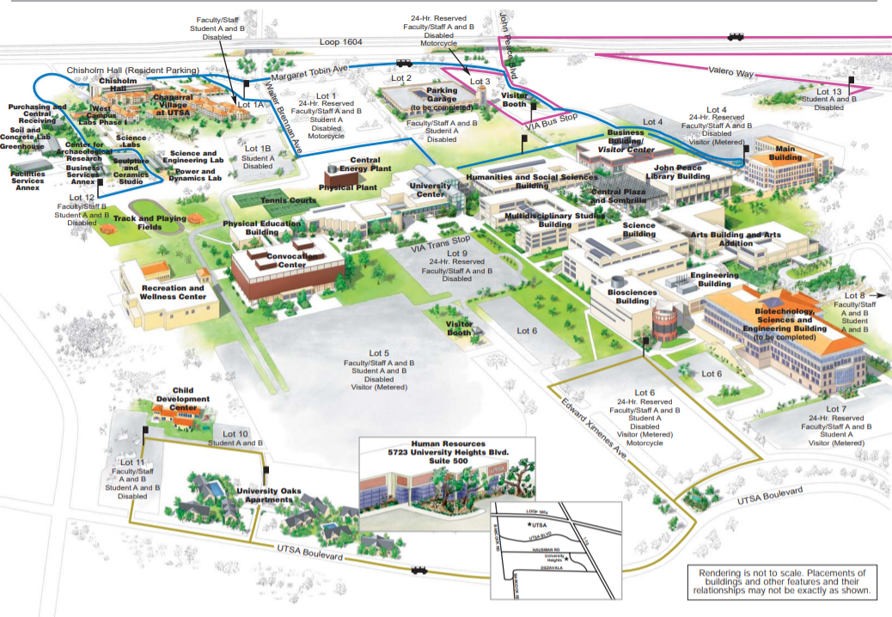
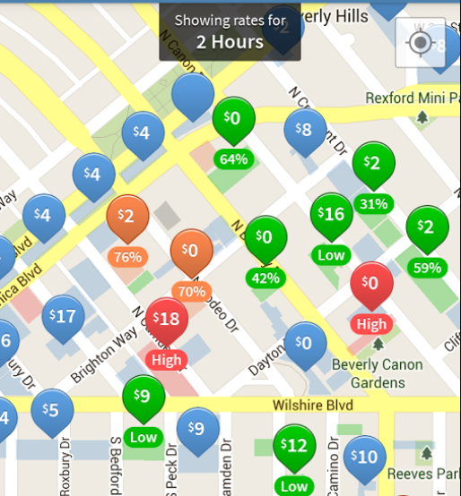
User Interface Design
UTSA CS 3443 - 001
Group 4 - UTSA Campus Parking App

